Slide 1
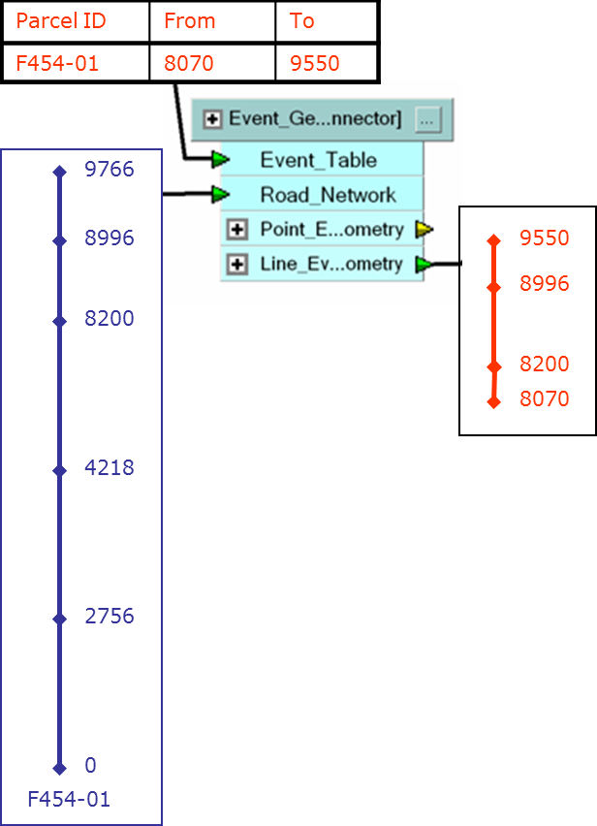
Linear referencing with FME
Knut Jetlund
Statens vegvesen
(Norwegian Public Roads Adminstration)

Slide 2
Introduction: Linear Referencing Systems
The fence is referenced to
Hwy 6, from 2.0 km to 2.8 km

Slide 3
Linear Referencing vs Segmentation

Slide 4
Linear Features and events

Slide 5
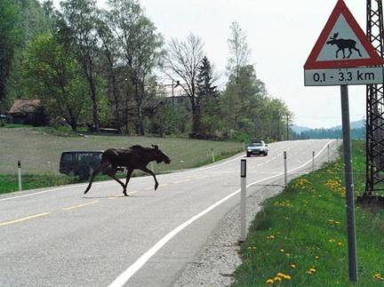
Usage Example
Identify road sections exposed for wildlife accidents, add information about streetlights and average traffic amount for each section

Slide 6
Input data
Road geometry
Tables with LR
Traffic Accidents
Streetlights
Traffic amount

Slide 7
Workflow
Calculate geometry for accidents
LRS to Geometry
Buffer accident points, dissolve overlapping areas
Calculate linear reference for the areas
Geometry to LRS
Overlay Accidents sections and Streetligths
Event overlay
Calculate geometry for Accident/Streetlight sections
LRS to Geometry
Calculate average traffic amount
Generalization – weighted average

Slide 8
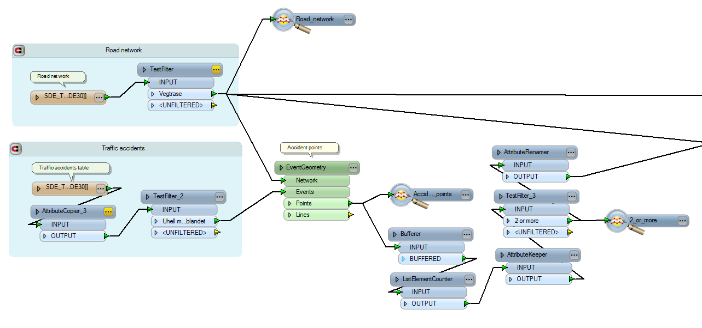
Road sections exposed for wildlife accidents
Calculate geometry for accidents
LRS to Geometry
Buffer accident points, dissolve overlapping areas

Slide 9
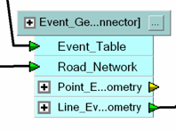
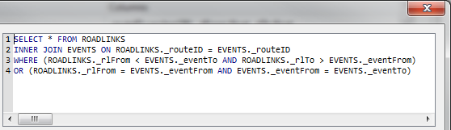
LRS to Geometry
Parcel ID | From | To
F454-01 | 8070 | 9550
Workflow highlights
InlineQuerier
Select relevant segments
ExpressionEvaluator
Calculate amount to snip
Snipper
Snip segments
LineJoiner
Join segments
9766
8996
9550
8996
8200
8200
8070
4218
2756
0
F454-01

Slide 10
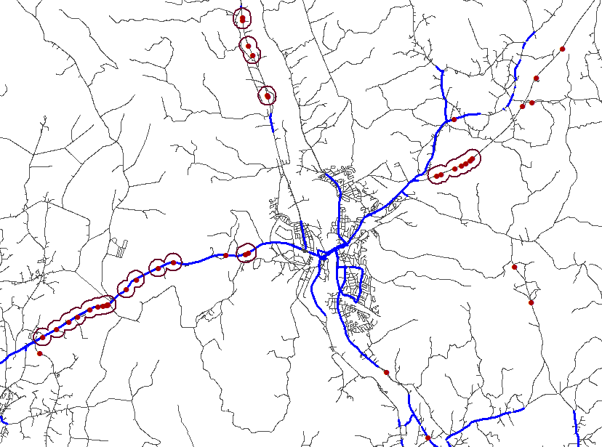
LRS to geometry Wildlife accidents and Streetlight sections

Slide 11
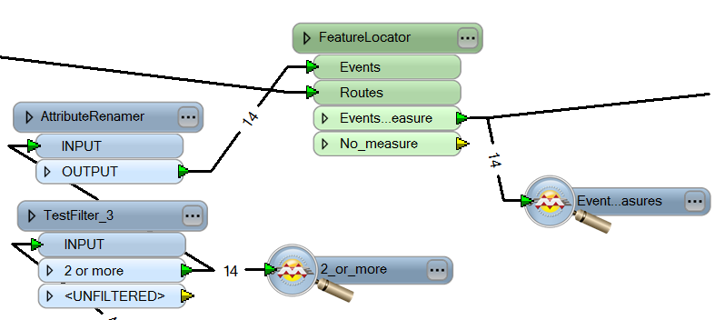
Accident sections - LRS
Calculate linear reference for the accident sections
Geometry to LRS

Slide 12

Geometry to LRS
Workflow highlights
Chopper
Extract vertices
NeighborFinder
Find closest point on the road for each vertex
LengthToPointCalculator
Calculate measure for the point
ExpressionEvaluator
Multiply with segment scale
Lists
Group by original feature
Find min. and max. measure
Find minimum distance
9766
8996
m_{max}
8745
8200
8156
5575
d_{min}
4218
4101
3009
2756
2538
m_{min}
1133
0
F454-01

Slide 13
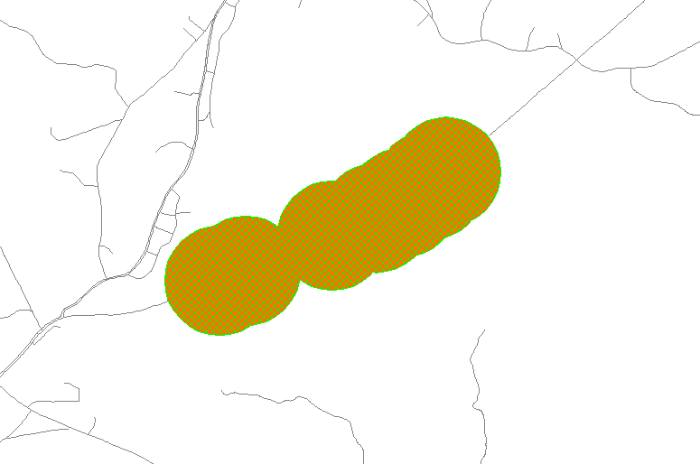
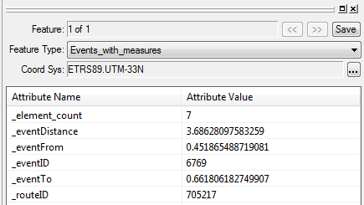
Accident sections - LRS

Slide 14
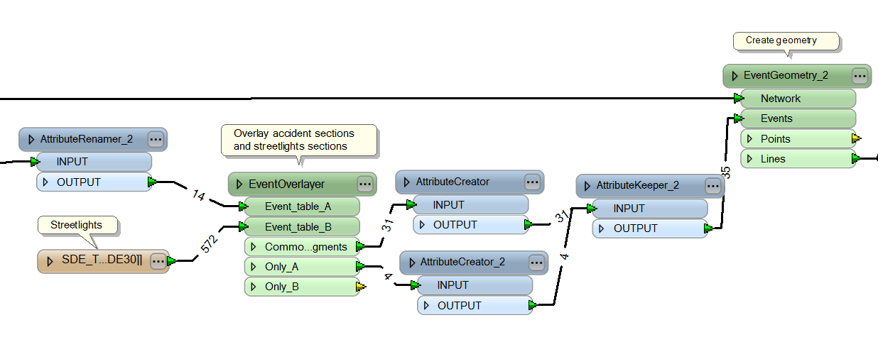
Accident sections and Streetlights
Overlay Accident sections and Streetlights
Event overlay
Calculate geometry for Accident/Streetlight sections

Slide 15
Event Overlay
Accident sections
Workflow highlights
Common segments
Segmentize features
Merge tables
6500
7500
10100
Streetlights
Streetligths
5010
7100 7200
9700
5010
7100 7200
9700
SEG ID | Parcel ID | From | To | Accidents | Street-lights
1 | F454-01 | 5010 | 6500
2 | F454-01 | 6500 | 7100 | Yes | Yes
3 | F454-01 | 7100 | 7200 | Yes
4 | F454-01 | 7200 | 7500 | Yes | Yes
5 | F454-01 | 7500 | 9700 | Yes | Yes
6 | F454-01 | 9700 | 10100 | Yes
6500
7500
10100
ID | Parcel ID | From | To | Accidents
A1 | F454-01 | 6500 | 7500 | Yes
A2 | F454-01 | 8200 | 10100 | Yes
ID | Parcel ID | From | To | Streetlights
B1 | F454-01 | 5010 | 7100 | Yes
B2 | F454-01 | 7200 | 9700 | Yes

Slide 16
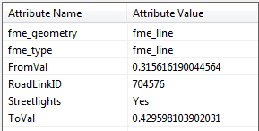
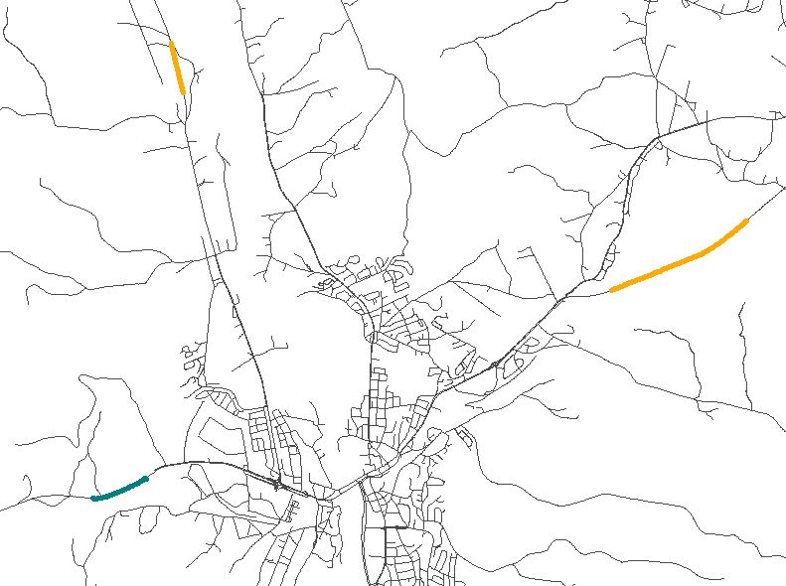
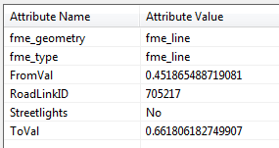
Accident/Streetlight sections

Slide 17
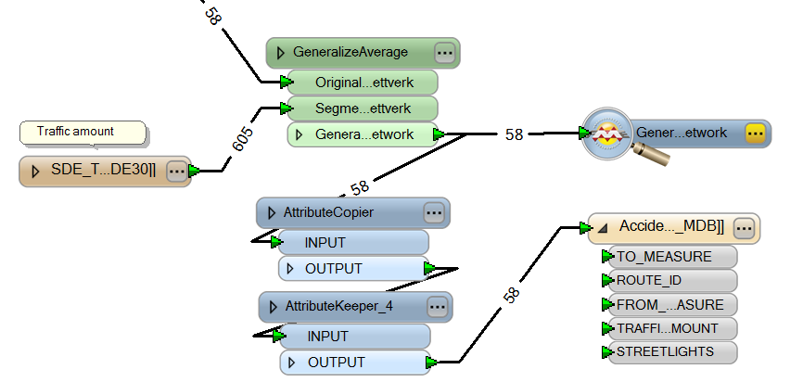
Average traffic amount
Calculate average traffic amount
Generalization – weighted average

Slide 18
Generalization
Accidents,
Streetlights
Accidents,
No streetlights
Workflow highlights
Overlapping segments
Weighted average
∑(Overlap length*value)
∑(Overlap length)
Dominating value
Longest overlapping segment
6500
7500
10100
5000
4000
5010
7100 7200
9700
5010
7100 7200
9700
6500
7500
10100
ID | Parcel ID | From | To | Streetlights | Length | Value
A1 | F454-01 | 6500 | 7500 | Yes | 600 | 5000
 |  |  |  |  | 100
 |  |  |  |  | 300 | 4000
A2 | F454-01 | 7500 | 10100 | No | 2200 | 4000
 |  |  |  |  | 400
l*v | Average
3000000 | 4667
1200000
8800000 | 4000
Dominating
5000
4000

Slide 19
Workflow
Calculate geometry for accidents
LRS to Geometry
Buffer accident points, dissolve overlapping areas
Calculate linear reference for the areas
Geometry to LRS
Overlay Accidents sections and Streetligths
Event overlay
Calculate geometry for Accident/Streetlight sections
LRS to Geometry
Calculate average traffic amount
Generalization – weighted average

Slide 20
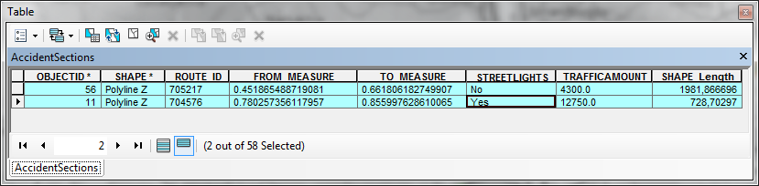
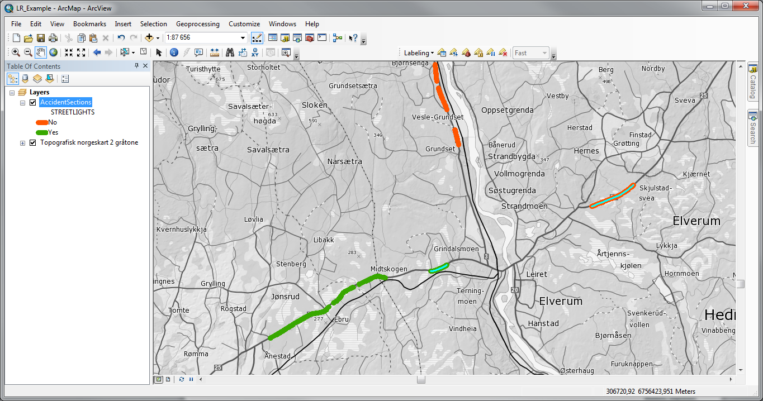
The Results...

Slide 21
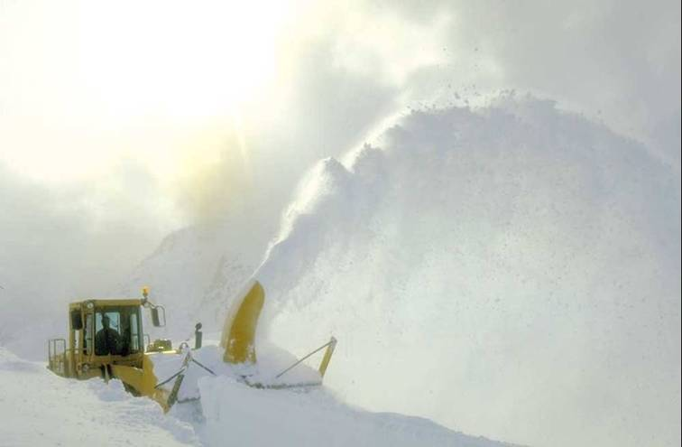
Thank You
QUESTIONS?
More information:
knut.jetlund@vegvesen.no

